Slide 1




Al-Azhar University
Faculty of Engineering
Systems and Computer Engineering Dept.
Intelligent Systems Engineering Program
ENG 142
Digital and Logic Design (2)
Prof. Ahmed Youssef

Slide 2
Course Contents
1 | Introduction | W1
2 | Sequential Logic Circuits | W2 - W3
3 | Sequential Logic Circuits Analysis | W4 - W5
4 | Sequential Logic Circuits Design | W6 - W7
5 | Registers, Counters | W9 – W11
6 | Programmable Devices | W12
7 | VHDL Circuit Simulation | W13

Slide 3
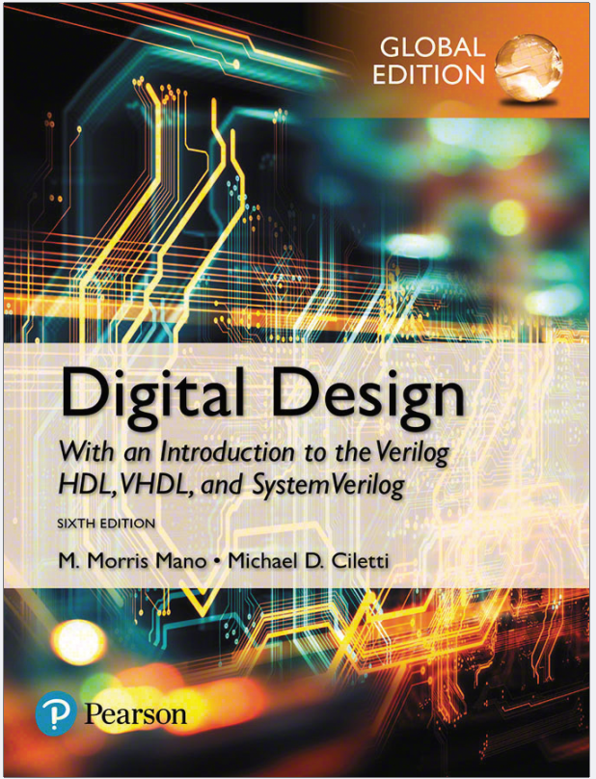

Slide 4

Grading Policy
100
40
Final Exam
30
30 Practical
Notes:
4

Slide 5
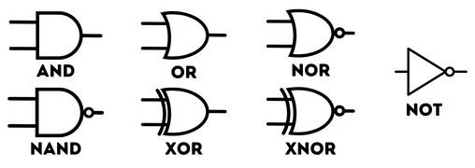
Logic Gates

Slide 6
Combinational Circuits
Combinational
circuit
(logic gates)
n binary
inputs
m binary
outputs
n input bits ➔ 2^{n} possible binary input combinations
Examples: adders, subtractors, comparators, decoders, encoders, and multiplexers.

Slide 7
Full Adder Using Half Adders
x
HA
HA
y
S
C
z

Slide 8
Integer Addition 2/2
a₃
b₃
a₂
b₂
a₁
b₁
a₀
b₀
FA
FA
FA
x
y
FA
y
y
C₄
x
y
C₃
x
C₂
x
C₁
C₀=0
C
z
C
z
C
z
C
z
S
S
S
S
S₃
S₂
S₁
S₀
Ripple-carry adder

Slide 9
Decoders
In general, for an n-bit code, a decoder could select up to 2^{n} lines:
n-bit
code
n to 2^{n}
decoder
2^{n}
output lines
:
:

Slide 10
Decoder Example
2-to-4-Line Decoder
A
0
A
1
A
0
D
0
D
1
D
2
D
3
A
1
0
0
1
0
0
0
D
5
A
A
0
1
0
1
0
0
0
1
0
1
0
0
0
1
0
1
1
0
0
0
1
D
1
5
A
1
A
0
(a)
D
2
5
A
1
A
0
D
3
5
A
1
A
0
(b)

Slide 11
4-to-1-Line Multiplexer: Circuit
I₀
I₁
I₀
0
I₁
1
Y
MUX
Y
I₂
I₂
2
I₃
3
I₃
S₁
S₀
Y = S₁’S₀’I₀ + S₁’S₀I₁ + S₁S₀’I₂ + S₁S₀I₃
S₁
S₀

Slide 12
Digital Design
With an Introduction to the Verilog HDL, VHDL, and SystemVerilog 6th Edition
Chapter 05
Synchronous Sequential Logic

Slide 13
Sequential Circuits Model
Combinational
Circuit
inputs
outputs
current
state
next
state
Memory
Elements
current state is a function of past inputs and initial state

Slide 14
Classification
Two types of sequential circuits
Synchronous
The state of the memory elements are updated with the arrival of each pulse
Synchronization is usually achieved through the use of a common clock
Asynchronous
No clock
behavior of an asynchronous sequential circuits depends upon the input signals at any instant of time and the order in which the inputs change.

Slide 15
Clocked Sequential Circuits
Memory elements are flip-flops which are logic devices, each of which is capable of storing one bit of information.
Combinational
Circuit
inputs
outputs
current
state
next
state
Flip-Flops
clock

Slide 16
Clocked Sequential Circuits
The outputs of a clocked sequential circuit can come from the combinational circuit, from the outputs of the flip-flops or both.
The state of the flip-flops can change only during a clock pulse transition
i.e. low-to-high and high-to-low
clock edge
When the clock maintains its value, the flip-flop output does not change
The transition from one state to the next occurs at the clock edge.

Slide 17
Latches
The most basic types of memory elements are latches.
A latch is a memory device that can maintain a binary state.
Latches are, in fact, asynchronous devices and they usually do not require a clock to operate.

Slide 18
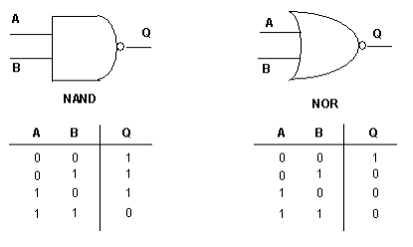
NAND/NOR
NAND
Any I/P =0 → O/P = 1
All I/Ps =1 → O/P = 0
NOR
Any I/P =1 → O/P = 0
All I/Ps =0 →O/P = 1

Slide 19
SR-Latch
made of cross-coupled NOR (or NAND) gates
R | S | Q(t) | Q(t+1) | State
0 | 0 | 0
0 | 0 | 1
0 | 1 | 0
0 | 1 | 1
1 | 0 | 0
1 | 0 | 1
1 | 1 | 0
1 | 1 | 1
R
Q
Q’
S

Slide 20
SR-Latch
made of cross-coupled NOR (or NAND) gates
R
Q
Q’
S
R | S | Q(t) | Q(t+1) | State
0 | 0 | 0 | 0 | No Change
0 | 0 | 1 | 1 | No Change
0 | 1 | 0 | 1 | Set
0 | 1 | 1 | 1 | Set
1 | 0 | 0 | 0 | Reset
1 | 0 | 1 | 0 | Reset
1 | 1 | 0 | ? | Undefined
1 | 1 | 1 | ? | Undefined

Slide 21
SR-Latches with NAND Gates
S
Q
Also known as S’R’-latch
Q’
R
R | S | Q(t) | Q(t+1) | State
0 | 0 | 0 | ? | Undefined
0 | 0 | 1 | ? | Undefined
0 | 1 | 0 | 0 | Reset
0 | 1 | 1 | 0 | Reset
1 | 0 | 0 | 1 | Set
1 | 0 | 1 | 1 | Set
1 | 1 | 0 | 0 | No Change
1 | 1 | 1 | 1 | No Change

Slide 22
SR-Latch with Control Input
Control inputs allow the changes at S and R to change the state of the latch.
S
Q
C
Q’
R
C | S | R | Q | Q’
0 | X | X | No change
1 | 0 | 0 | No change
1 | 0 | 1 | Q = 0 | Reset state
1 | 1 | 0 | Q = 1 | Set state
1 | 1 | 1 | Indeterminate

Slide 23
D-Latch
SR latches are seldom used in practice because the indeterminate state may cause instability
Remedy: D-latches
D
S
Q
C
R
Q’
This circuit guarantees that the inputs to the S’R’-latch
is always complement of each other when C = 1.

Slide 24
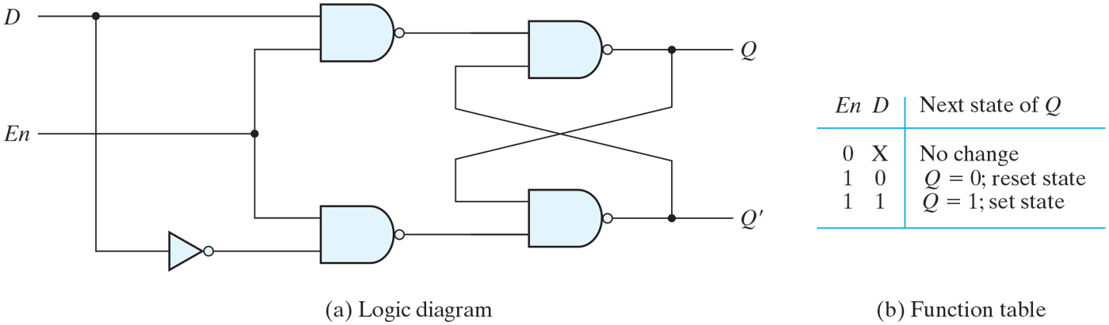
D-Latch as a Storage Unit
D–latches can be used as temporary storage
The input of D-latch is transferred to the Q output when C = 1
When C = 0 the binary information is retained.

Slide 25
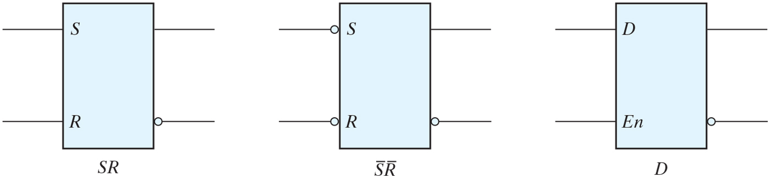
Graphic symbols for latches.

Slide 26
Need for Flip-Flops
Outputs may keep changing so long as C = 1
Combinational
Circuit
inputs
outputs
current
state
next
state
Latches
C

Slide 27
Need for Flip-Flops
The states of the memory elements must change synchronously
memory elements should respond to the changes in input at certain points in time.
This is the very characteristics of synchronous circuits.
To this end, we use flip-flops that change states during a signal transition of control input (clock)

Slide 28
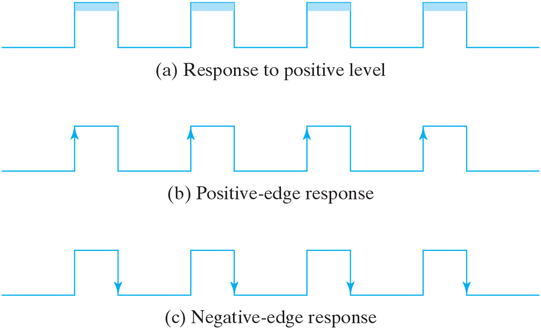
Clock response in flip-flop.

Slide 29
Edge-Triggered D Flip-Flop
An edge-triggered D flip-flop can be constructed using two D latches
Y
D latch
(master)
D latch
(slave)
Q
D
D
Q
D
Q
C
C
clk’
Y = D
clk
clk
Y does not change
clk
Q = Y = D
D
clk’
Y
Negative edge-triggered
D flip-flop
Q

Slide 30
Positive Edge-Triggered D Flip-Flop
Y
D latch
(master)
D latch
(slave)
Q
D
D
Q
D
Q
clk’
C
C
clk
clk
Y= D
clk’
Y does not change
Q = Y = D
clk

Slide 31
Symbols for D Flip-Flops
D FF
D
Q
Positive edge-triggered
D Flip-Flop
clk
C
D FF
D
Q
Negative edge-triggered
D Flip-Flop
clk
C

Slide 32
D Flip-Flop
D FF
D
Q
Positive edge-triggered
D Flip-Flop
clk
C
D | Q(t+1)
0 | 0
1 | 1
Characteristic equation
Q(t+1) = D
Characteristic Table

Slide 33
Other Flip-Flops
D flip-flop is the most common
since it requires the fewest number of gates to construct.
Two other widely used flip-flops
JK flip-flops
T flip-flops
JK flip-flops
Three FF operations
Set
Reset
Complement

Slide 34
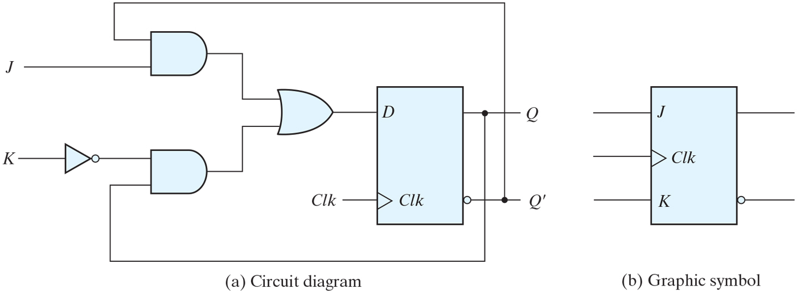
JK flip-flop.

Slide 35
JK Flip-Flops
J | K | Q(t+1) | next state
0 | 0 | Q(t) | no change
0 | 1 | 0 | Reset
1 | 0 | 1 | Set
1 | 1 | Q’(t) | Complement
J
Q
C
K
Characteristic Table
Characteristic equation
Q(t+1) = JQ’(t) + K’Q(t)

Slide 36
T (Toggle) Flip-Flop
Complementing flip-flop
T | Q(t+1) | next state
0 | Q(t) | no change
1 | Q’(t) | Complement
T
Q
C
Characteristic Table
Characteristic equation
Q(t+1) =
T
J
Q
T
D
Q
C
C
K

Slide 37
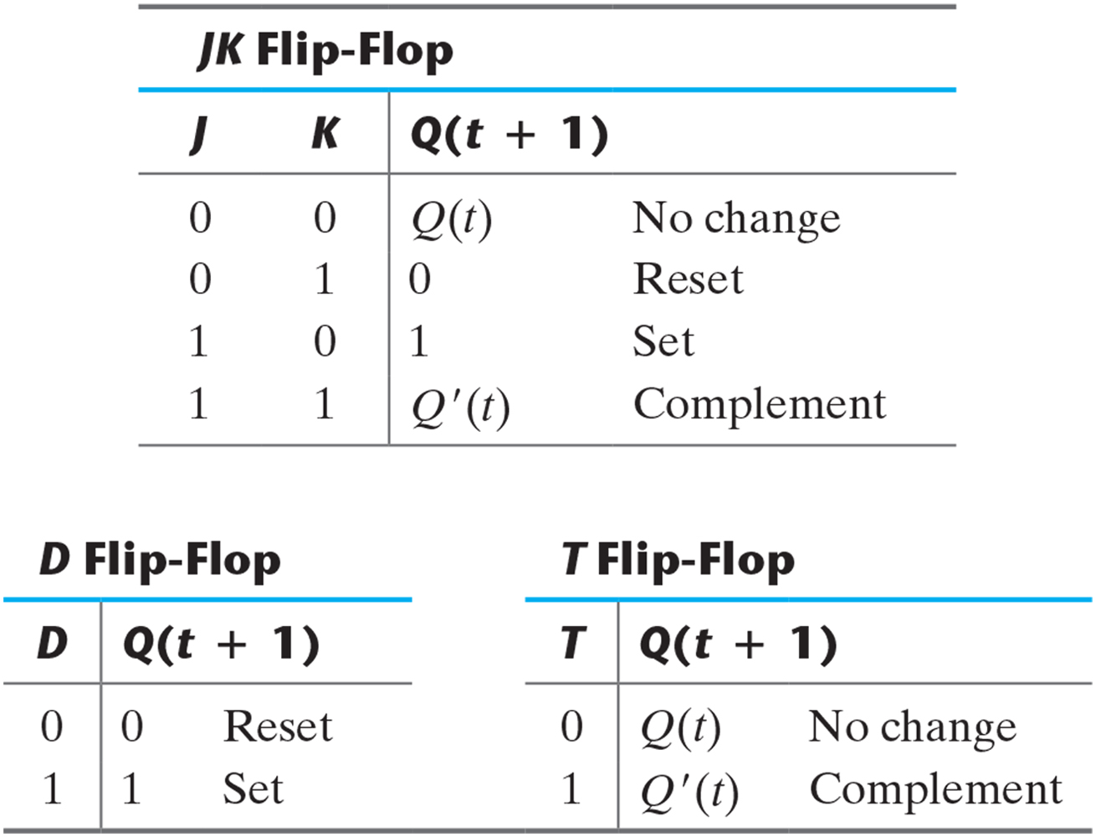
Table 5.1 Flip-Flop Characteristic Tables.

Slide 38
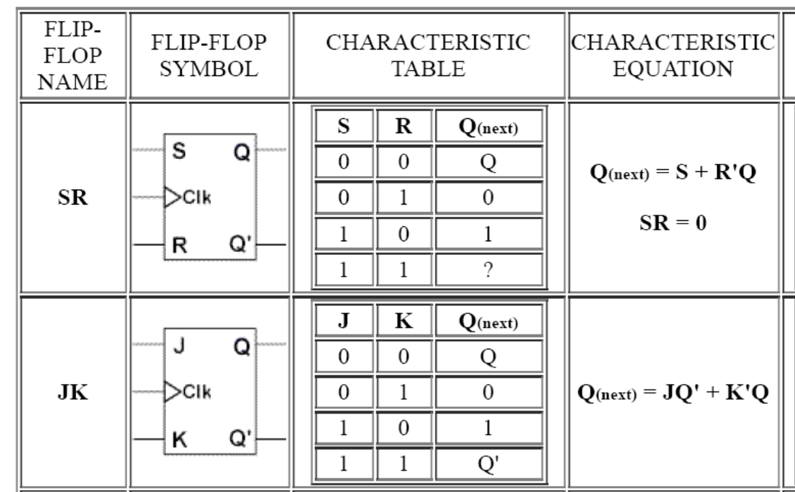

Slide 39
